Slide 1
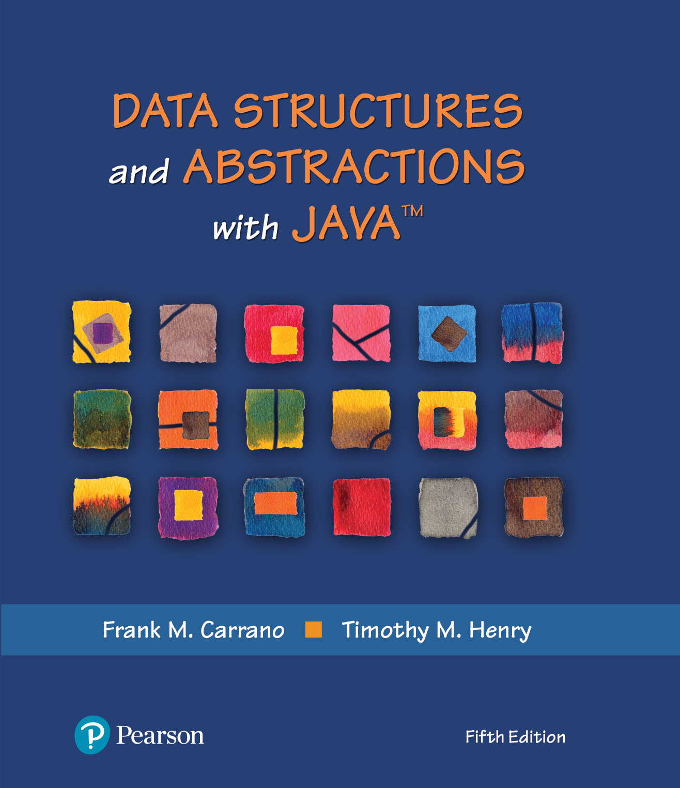
Data Structures and Abstractions with Java™
5th Edition
Module 5 – Linked Based ADT
Includes:
Chapter 3 - A Bag
Implementation
That Links Data

Slide 2
What Is an Iterator?
An object that traverses a collection of data
During iteration, each data item is considered once
Possible to modify item as accessed
Should implement as a distinct class that interacts with the ADT

Slide 3
Problems with Array Implementation
Array has fixed size
May become full
Alternatively may have wasted space
Resizing is possible but requires overhead of time

Slide 4
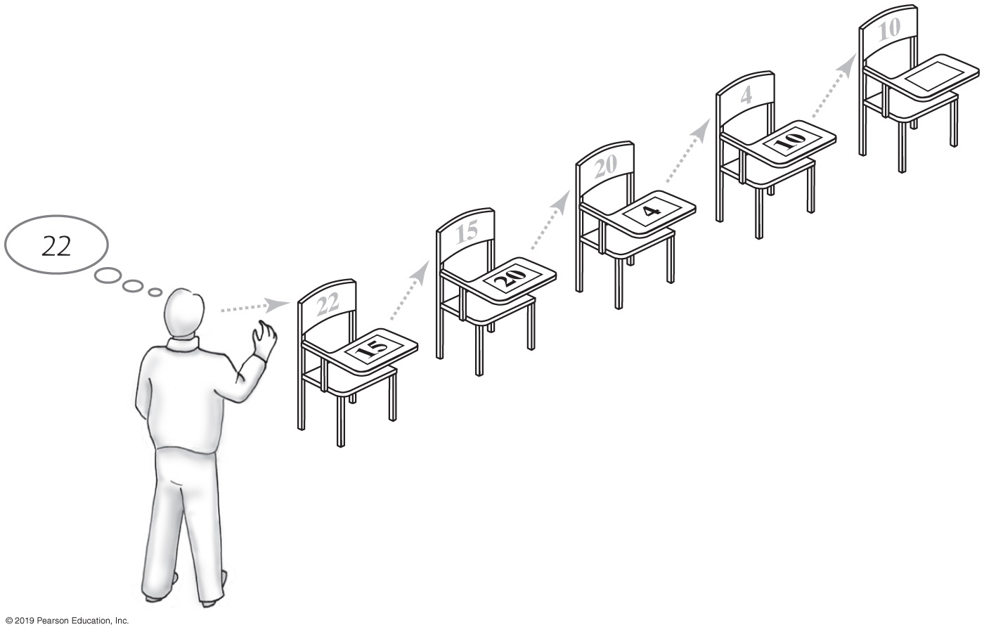
Analogy
Empty classroom
Numbered desks stored in hallway
Number on back of desk is the “address”
Number on desktop references another desk in chain of desks
Desks are linked by the numbers
FIGURE 3-1 A chain of five desks

Slide 5
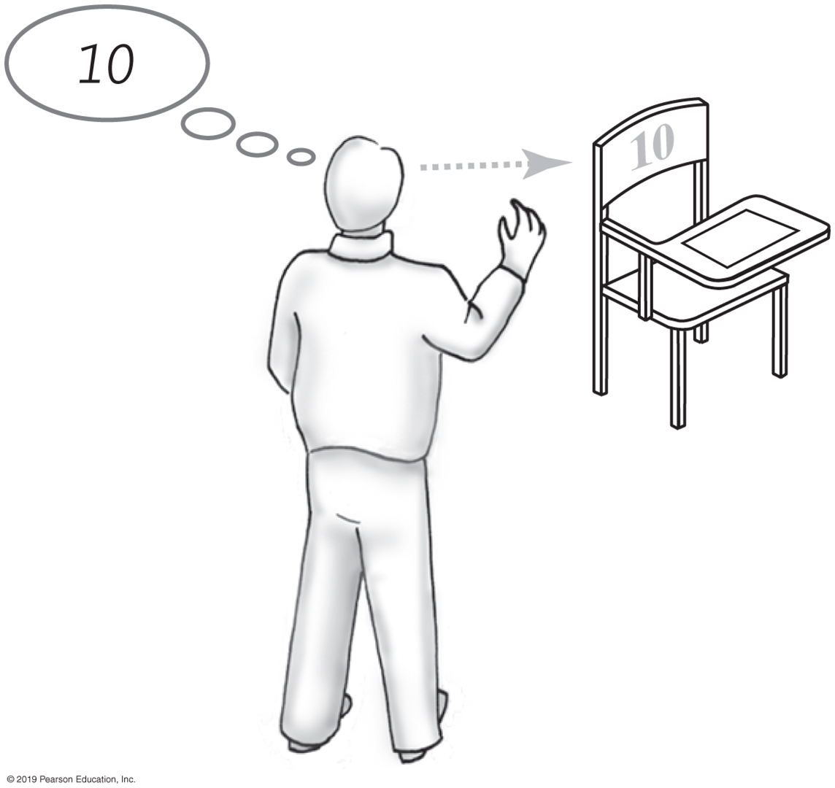
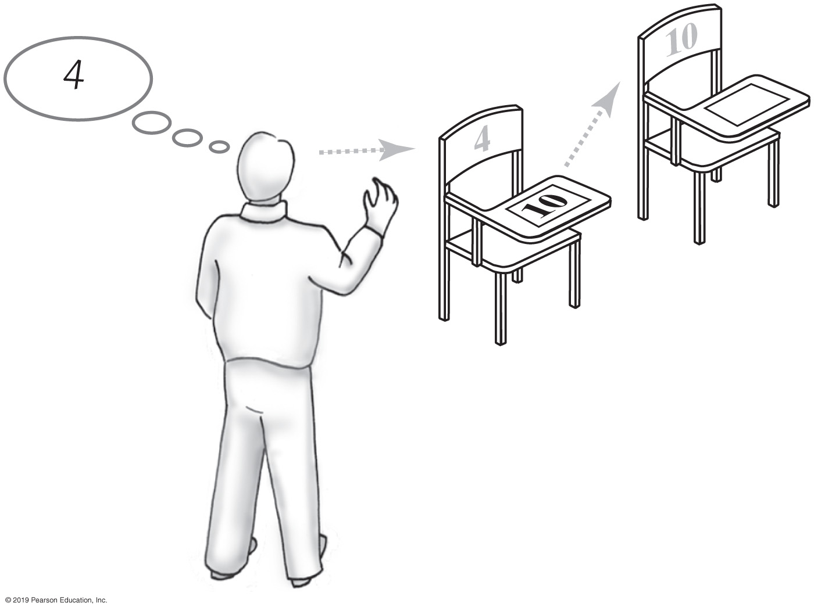
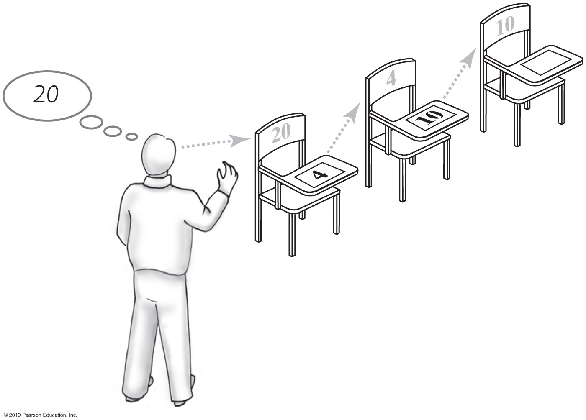
Forming a Chain by Adding to Its Beginning
FIGURE 3-2
One desk in the room
FIGURE 3-3
Two linked desks, with the newest desk first
FIGURE 3-4 Three linked desks, with the newest desk first

Slide 6
Noncontiguous Structures
Do not require contiguous (sequential) memory
Client need not specify the maximum number of nodes to be stored in the structure
They can utilize fragmented memory,
Unused memory
Fragmented RAM Memory
Application A
20 Kbytes
Unused
Application B
20 Kbytes
Unused
Application C
20 Kbytes
Unused

Slide 7
Linked Lists
Noncontiguous dynamic structures
Expand and contract at runtime during every Insert/Delete operation, therefore
Memory frugal
Never assigned more memory than they need
Share two common characteristics
Every node has a field that is a node reference, called a link field
Every node’s address is stored in at least one other node (except perhaps the unique first node)
The link fields locate and order the nodes

Slide 8
Forming a Chain by Adding to Its Beginning
// Process the first student
newDesk represents the new student’s desk New student sits at newDesk
Instructor memorizes the address of newDesk
// Process the remaining students
while (students arrive)
{
newDesk represents the new student’s desk New student sits at newDesk
Write the instructor’s memorized address on newDesk
Instructor memorizes the address of newDesk
}
Pseudocode detailing steps taken to form a chain of desks

Slide 9
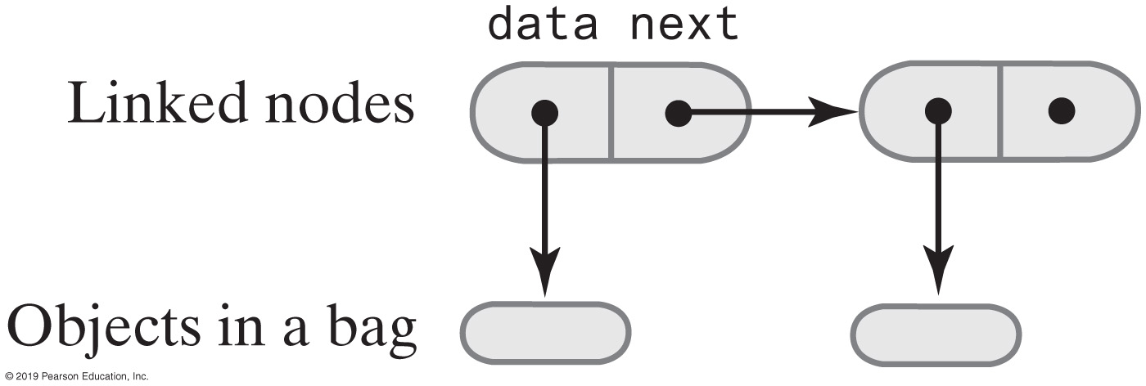
The Private Class Node
private class Node
{
private T data; // Entry in bag
private Node next; // Link to next node
private Node(T dataPortion)
{
this(dataPortion, null);
} // end constructor
private Node(T dataPortion, Node nextNode)
{
data = dataPortion;
next = nextNode;
} // end constructor
} // end Node
FIGURE 3-5 Two linked nodes that each reference object data
LISTING 3-1 The private inner class Node

Slide 10
An Outline of the Class LinkedBag (Part 1)
/** OUTLINE
A class of bags whose entries are stored in a chain of linked nodes.
The bag is never full. */
public class LinkedBag<T> implements BagInterface<T>
{
private Node firstNode; // reference to first node
private int numberOfEntries;
public LinkedBag()
{
firstNode = null;
numberOfEntries = 0;
} // end default constructor
// . . .
LISTING 3-2 An outline of the class LinkedBag

Slide 11
An Outline of the Class LinkedBag (Part 2)
private class Node
{
private T data; // Entry in bag
private Node next; // Link to next node
private Node(T dataPortion)
{
this(dataPortion, null);
} // end constructor
private Node(T dataPortion, Node nextNode)
{
data = dataPortion;
next = nextNode;
} // end constructor
} // end Node
} // end LinkedBag
LISTING 3-2 An outline of the class LinkedBag

Slide 12
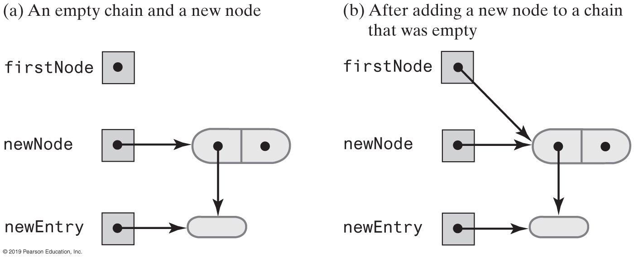
Beginning a Chain of Nodes
FIGURE 3-6 Adding a new node to an empty chain

Slide 13
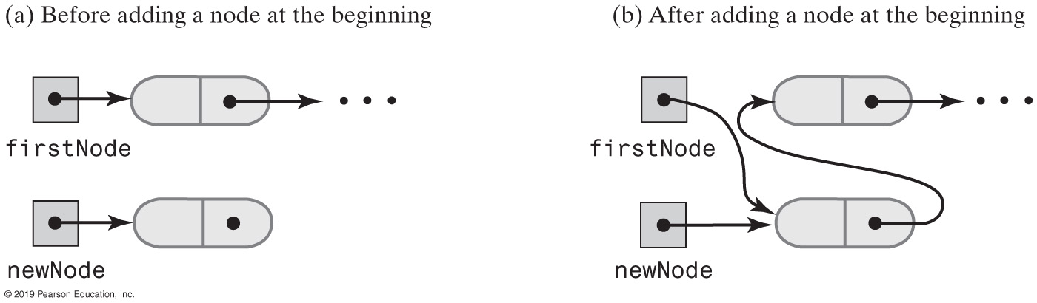
Beginning a Chain of Nodes
FIGURE 3-7 A chain of nodes just before and just after adding a node at the beginning

Slide 14
Beginning a Chain of Nodes
/** Adds a new entry to this bag.
@param newEntry The object to be added as a new entry.
@return True. */
public boolean add(T newEntry) // OutOfMemoryError possible
{
// Add to beginning of chain:
Node newNode = new Node(newEntry);
newNode.next = firstNode; // Make new node reference rest of chain
// (firstNode is null if chain is empty)
firstNode = newNode; // New node is at beginning of chain
numberOfEntries++;
return true;
} // end add
The method add

Slide 15
Method toArray
/** Retrieves all entries that are in this bag.
@return A newly allocated array of all the entries in the bag. */
public T[] toArray()
{
// The cast is safe because the new array contains null entries
@SuppressWarnings("unchecked")
T[] result = (T[])new Object[numberOfEntries]; // Unchecked cast
int index = 0;
Node currentNode = firstNode;
while ((index < numberOfEntries) && (currentNode != null))
{
result[index] = currentNode.data;
index++;
currentNode = currentNode.next;
} // end while
return result;
} // end toArray
The method toArray returns an array of the entries currently in a bag

Slide 16
LinkedBag Test Program (Part 1)
/** A test of the methods add, toArray, isEmpty, and getCurrentSize,
as defined in the first draft of the class LinkedBag. */
public class LinkedBagDemo1
{
public static void main(String[] args)
{
System.out.println("Creating an empty bag.");
BagInterface<String> aBag = new LinkedBag1<>();
testIsEmpty(aBag, true);
displayBag(aBag);
String[] contentsOfBag = {"A", "D", "B", "A", "C", "A", "D"};
testAdd(aBag, contentsOfBag);
testIsEmpty(aBag, false);
} // end main
LISTING 3-3 A sample program that tests some methods in the class LinkedBag

Slide 17
LinkedBag Test Program (Part 2)
// Tests the method isEmpty.
// Precondition: If bag is empty, the parameter empty should be true;
// otherwise, it should be false.
private static void testIsEmpty(BagInterface<String> bag, boolean empty)
{
System.out.print("\nTesting isEmpty with ");
if (empty)
System.out.println("an empty bag:");
else
System.out.println("a bag that is not empty:");
System.out.print("isEmpty finds the bag ");
if (empty && bag.isEmpty())
System.out.println("empty: OK.");
else if (empty)
System.out.println("not empty, but it is: ERROR.");
else if (!empty && bag.isEmpty())
System.out.println("empty, but it is not empty: ERROR.");
else
System.out.println("not empty: OK.");
} // end testIsEmpty
LISTING 3-3 A sample program that tests some methods in the class LinkedBag

Slide 18
LinkedBag Test Program (Part 3)
// Tests the method add.
private static void testAdd(BagInterface<String> aBag, String[] content)
{
System.out.print("Adding the following strings to the bag: ");
for (int index = 0; index < content.length; index++)
{
if (aBag.add(content[index]))
System.out.print(content[index] + " ");
else
System.out.print("\nUnable to add " + content[index] +
" to the bag.");
} // end for
System.out.println();
displayBag(aBag);
} // end testAdd
LISTING 3-3 A sample program that tests some methods in the class LinkedBag

Slide 19
LinkedBag Test Program (Part 4)
// Tests the method toArray while displaying the bag.
private static void displayBag(BagInterface<String> aBag)
{
System.out.println("The bag contains the following string(s):");
Object[] bagArray = aBag.toArray();
for (int index = 0; index < bagArray.length; index++)
{
System.out.print(bagArray[index] + " ");
} // end for
System.out.println();
} // end displayBag
} // end LinkedBagDemo1
Program Output
Creating an empty bag.
Testing isEmpty with an empty bag:
isEmpty finds the bag empty: OK.
The bag contains the following string(s):
Adding the following strings to the bag: A D B A C A D
The bag contains the following string(s):
D A C A B D A
Testing isEmpty with a bag that is not empty:
isEmpty finds the bag not empty: OK.
LISTING 3-3 A sample program that tests some methods in the class LinkedBag

Slide 20
Method getFrequencyOf
/** Counts the number of times a given entry appears in this bag.
@param anEntry The entry to be counted.
@return The number of times anEntry appears in the bag. */
public int getFrequencyOf(T anEntry)
{
int frequency = 0;
int loopCounter = 0;
Node currentNode = firstNode;
while ((loopCounter < numberOfEntries) && (currentNode != null))
{
if (anEntry.equals(currentNode.data))
{
frequency++;
} // end if
loopCounter++;
currentNode = currentNode.next;
} // end while
return frequency;
} // end getFrequencyOf
Counts the number of times a given entry appears

Slide 21
Method contains
/** Tests whether this bag contains a given entry.
@param anEntry The entry to locate.
@return True if the bag contains anEntry, or false otherwise */
public boolean contains(T anEntry)
{
boolean found = false;
Node currentNode = firstNode;
while (!found && (currentNode != null))
{
if (anEntry.equals(currentNode.data))
found = true;
else
currentNode = currentNode.next;
} // end while
return found;
} // end contains
Determine whether a bag contains a given entry

Slide 22
Removing an Item from a Linked Chain
Case 1:
Your desk is first in the chain of desks.
Case 2:
Your desk is not first in the chain of desks.

Slide 23
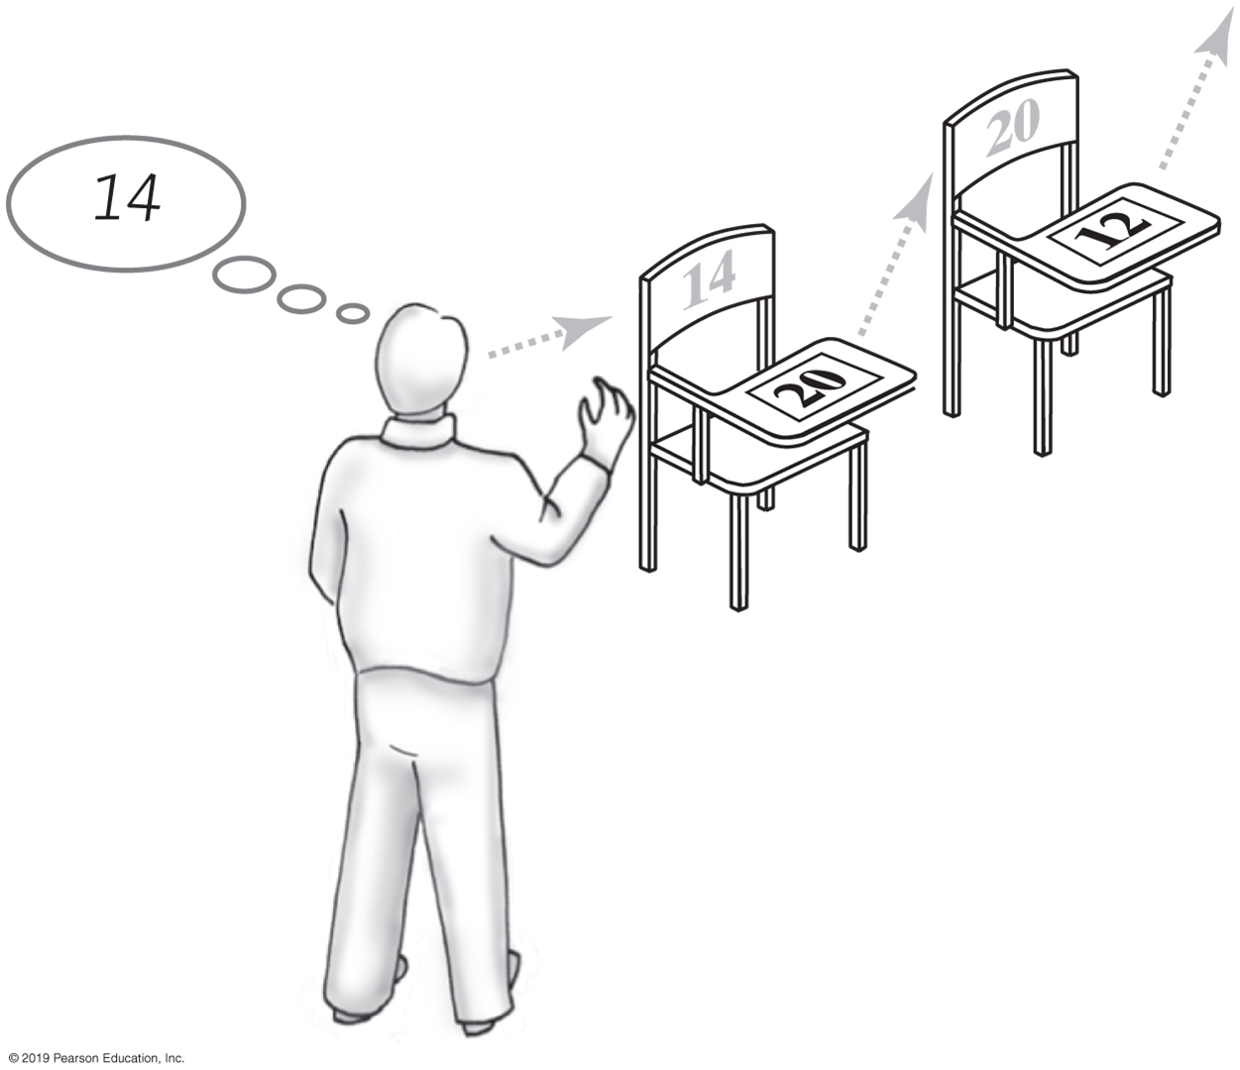
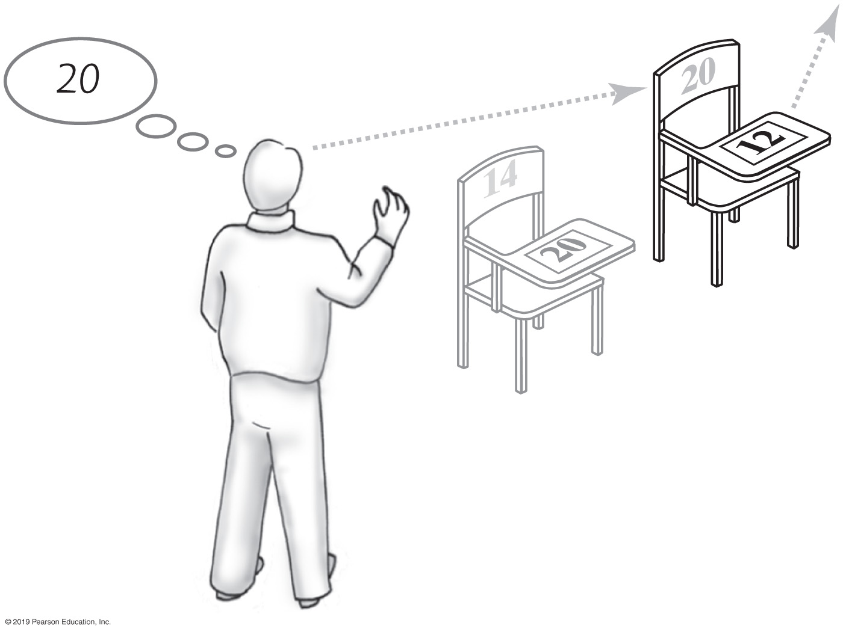
Removing an Item from a Linked Chain
Case 1
Locate first desk by asking instructor for its address.
Give address written on the first desk to instructor.
This is address of second desk in chain.
Return first desk to hallway.
FIGURE 3-8
A chain of desks just prior to removing its first desk
FIGURE 3-9
A chain of desks just after removing its first desk

Slide 24
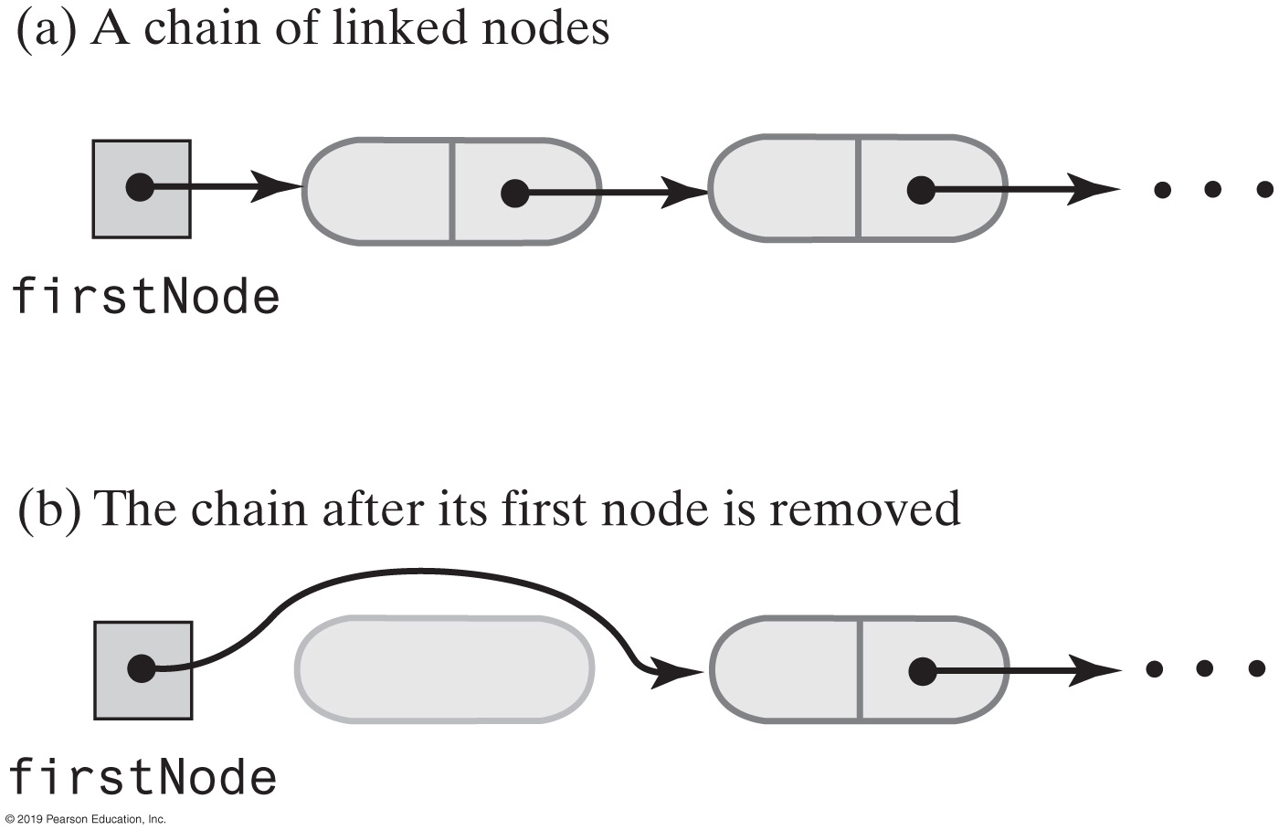
Removing an Item from a Linked Chain
FIGURE 3-10 A chain of nodes just before and just after its first node is removed

Slide 25
Removing an Item from a Linked Chain
Case 2
Move the student in the first desk to your former desk.
Remove the first desk using the steps described for Case 1.

Slide 26
Method remove
// Locates a given entry within this bag.
// Returns a reference to the node containing the entry, if located,
// or null otherwise.
private Node getReferenceTo(T anEntry)
{
boolean found = false;
Node currentNode = firstNode;
while (!found && (currentNode != null))
{
if (anEntry.equals(currentNode.data))
found = true;
else
currentNode = currentNode.next;
} // end while
return currentNode;
} // end getReferenceTo
Private helper method getReferenceTo

Slide 27
Method remove
/** Removes one unspecified entry from this bag, if possible.
@return Either the removed entry,
if the removal was successful, or null */
public T remove()
{
T result = null;
if (firstNode != null)
{
result = firstNode.data;
firstNode = firstNode.next; // Remove first node from chain
numberOfEntries--;
} // end if
return result;
} // end remove
Uses private helper method getReferenceTo

Slide 28
Method clear
/** Removes all entries from this bag. */
public void clear()
{
while (!isEmpty())
remove();
} // end clear
As in previous implementations, uses isEmpty and remove

Slide 29
Class Node That Has Set and Get Methods
private class Node
{
private T data; // Entry in bag
private Node next; // Link to next node
private Node(T dataPortion)
{
this(dataPortion, null);
} // end constructor
private Node(T dataPortion, Node nextNode)
{
data = dataPortion;
next = nextNode;
} // end constructor
private T getData()
{
return data;
} // end getData
private void setData(T newData)
{
data = newData;
} // end setData
private Node getNextNode()
{
return next;
} // end getNextNode
private void setNextNode(Node nextNode)
{
next = nextNode;
} // end setNextNode
} // end Node
LISTING 3-4 The inner class Node with set and get methods

Slide 30
A Class within A Package
package BagPackage;
class Node<T>
{
private T data;
private Node<T> next;
Node(T dataPortion)
{
this(dataPortion, null);
} // end constructor
Node(T dataPortion, Node<T> nextNode)
{
data = dataPortion;
next = nextNode;
} // end constructor
T getData()
{
return data;
} // end getData
void setData(T newData)
{
data = newData;
} // end setData
Node<T> getNextNode()
{
return next;
} // end getNextNode
void setNextNode(Node<T> nextNode)
{
next = nextNode;
} // end setNextNode
} // end Node
LISTING 3-5 The class Node with package access

Slide 31
When Node Is in Same Package
package BagPackage;
public class LinkedBag<T> implements BagInterface<T>
{
private Node<T> firstNode;
public boolean add(T newEntry)
{
Node<T> newNode = new Node<T>(newEntry);
newNode.setNextNode(firstNode);
firstNode = newNode;
numberOfEntries++;
return true;
} // end add
// . . .
} // end LinkedBag
LISTING 3-6 The class LinkedBag when Node is in the same package

Slide 32
Pros of Using a Chain
Bag can grow and shrink in size as necessary.
Remove and recycle nodes that are no longer needed
Adding new entry to end of array or to beginning of chain both relatively simple
Similar for removal

Slide 33
Cons of Using a Chain
Removing specific entry requires search of array or chain
Chain requires more memory than array of same length

Slide 34
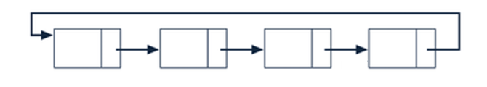
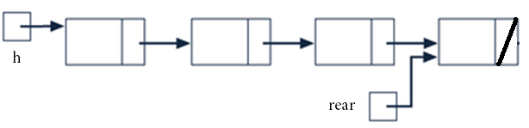
Other Types Of Linked Lists
Singly linked variations
Circular
The last node references the dummy node
Double-Ended
A reference variable references the last node
Sorted
Nodes are stored in key field sorted order
34
34
34

Slide 35
Circular Singly Linked List
l
next
firstNode
null
180
200
l
next
l
next
l
next
l
next
649
300
20
54
973
5
332
200
180
300
54
5
T’s key
info
X’s key
info
G’s key
info
B’s key
info
649
20
973
332

Slide 36
Circular Singly Linked List Algorithms
Same as the Singly Linked list algorithms except
In the Initialization algorithm, the first node is made to reference itself
firstNode.next = firstNode

Slide 37
Double-Ended Singly Linked List
Insertions can be made at the end of the list
Advantage: Ideally suited for a linked implementation of a Queue
l
next
firstNode
null
180
rear
5
200
l
next
l
next
l
next
l
next
649
300
20
54
973
5
332
null
180
300
54
5
T’s key
info
X’s key
info
G’s key
info
B’s key
info
649
20
973
332

Slide 38
Double-Ended Singly Linked List Algorithms
Initialization
rear = null; // for an empty list
A method is added to insert nodes at the end of the list (to facilitate an enqueue operation)
if(rear == null) // empty list
{ rear = new Node(); // a linked list node
firstNode.next = rear;
else
{ rear.next = new Node(); // a linked list node
rear = rear.next;
}
rear.data = deepCopy(newNode) // add the new information

Slide 39
Sorted Singly Linked list
Advantage: Output traversal outputs the node in sorted order
l
next
h
200
null
180
200
l
next
l
next
l
next
l
next
332
300
973
54
649
5
20
null
180
300
54
5
B’s key
info
G’s key
info
T’s key
info
X’s key
info
332
973
649
20
What methods would need to be modified to stay sorted?

Slide 40
Sorted Singly Linked List Algorithms
Same as Singly Linked list except
The add algorithm is modified
Uses a binary search to find insertion point
Search continues until a node is found whose key is greater than the new node’s key, or the last node is found
In the remove algorithm
The sequential search Boolean condition is expanded to halt when a node is found whose key is greater than the given key
Halt on expanded condition means key not found

Slide 41
Other Types Of Linked Lists
Doubly Linked list
Each node has a 2nd link field to reference predecessor
Multilinked list
Allow more than one traversal path through the nodes
41
41
41

Slide 42
Doubly Linked List
A link field, back, added to each Node
Advantage: Permits backward traversal through the list
back
next
firstNode
null
null
180
200
back
l
next
back
l
next
back
l
next
null
649
300
180
20
54
300
973
null
180
300
54
T’s key
info
X’s key
info
G’s key
info
649
20
973
What is the value of firstNode.next.next.back?
180

Slide 43
Doubly Linked List Operation Algorithms
1. Node n = new Node(); // create a new linked Node
2a. n.next = h.next; // add the linked Node object to the
2b. firstNode.next = n; // front of the linked list
3. n.data = newListing.deepCopy();
Fetch algorithm the same as the Singly Linked list
Initialize, Insert, and Delete algorithms modified to include the setting of the back link
Initialize adds: firstNode.back = null;
Insert adds: firstNode.next.back = n; // n is the new node
after Line 2a
Delete adds: if(p.next!= null) // not last node
{ p.next.back = p.back;}
after Line 3 (p references the node to be deleted)

Slide 44
Multilinked List Implemented As Two Singly Linked Lists
l
next
h1
200
null
180
200
the first singly linked list
l
next
l
next
l
next
l
next
332
300
973
54
649
5
20
null
180
300
54
5
the client’s information
B’s key
info
G’s key
info
T’s key
info
X’s key
info
332
973
649
20
l
next
l
next
l
next
l
next
649
621
332
32
973
256
20
null
the second singly linked list
452
621
32
256
l
next
h2
392
null
452
392
Each of the linked list are ordered differently – i.e. alpha order and age order

Slide 45
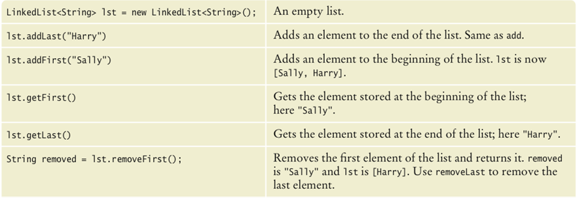
Java’s LinkedList class methods
Generic class
Specify type of elements in angle brackets: LinkedList<Product>
Package: java.util

Slide 46
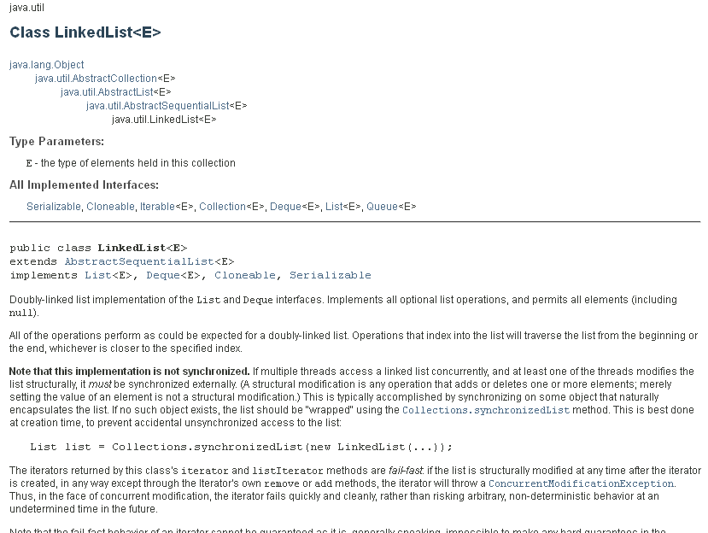

Slide 47
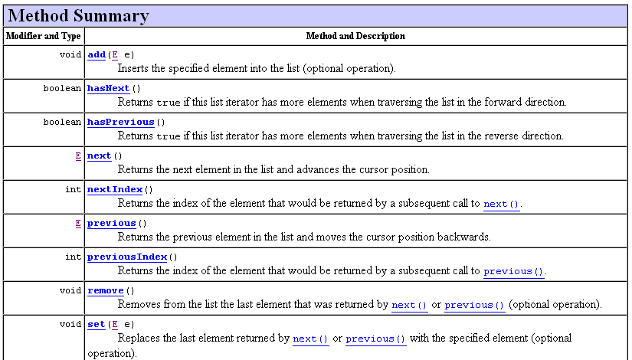
Java’s LinkedList class
LinkedList is a doubly linked list
Class stores two links:
One to the next element, and
One to the previous element
To move the list position backwards, use:
hasPrevious
previous

Slide 48
Linked List as an Array of Records
(a) A sequential list in static storage
list
.length
.info
public class ListType
{
int length;
char info[5]
};
ListType list;
list = new ListType();
5
A
B
C
D
E
[0]
[1]
[2]
[3]
[4]

Slide 49
Linked List as an Array of Records
A linked list in static storage
list
protected class NodeType
{
char info;
int next;
};
public class ListType
{
NodeType nodes[5];
int first;
};
ListType list = new ListType();
.nodes
[0]
[1]
[2]
[3]
[4]
C
B
E
A
D
3
4
0
-1
1
2
.first

Slide 50
Linked List as an Array of Records
nodes
.info
.next
[0]
[1]
[2]
[3]
[4]
[5]
[6]
[7]
[8]
[9]
4
5
6
8
7
3
-1
2
9
-1
An array with a linked
list of values and free space
David
Miriam
Joshua
Robert
list
free
0
1
Leah

Slide 51
nodes
.info
.next
[0]
[1]
[2]
[3]
[4]
[5]
[6]
[7]
[8]
[9]
4
5
6
8
7
3
-1
2
9
-1
David
list
free
0
1
Miriam
Joshua
Robert
Leah
list
David Joshua Leah Miriam Robert
free
Position 1 Position 5 Position 3 Position 8 Position 9

Slide 52
Linked List as an Array of Records
nodes
.info
.next
Add to beginning of list
temp = list
list = free
free = nodes[free].next
nodes[list].info = “Eric”
nodes[list].next = temp
[0]
[1]
[2]
[3]
[4]
[5]
[6]
[7]
[8]
[9]
4
5
6
8
7
3
-1
2
9
-1
David
Miriam
Joshua
Robert
list
free
0
1
Leah
What would be the algorithm for adding “Eric”?
Is it easier to add to beginning of list or end of list?

Slide 53
Linked List as an Array of Records
nodes
.info
.next
[0]
[1]
[2]
[3]
[4]
[5]
[6]
[7]
[8]
[9]
4
5
6
8
7
3
-1
2
9
-1
David
Traverse to find nodes[x].info = “Joshua”
temp = x (index of Joshua)
Traverse to find nodes[y].next = temp
before = y (index of node before Joshua)
nodes[before].next = nodes[temp].next
nodes[temp].info = “”
nodes[temp].next = free
free = temp
Miriam
Joshua
Robert
list
free
0
1
Leah
What would be the algorithm for deleting “Joshua”?

Slide 54
Linked List as an Array of Records
nodes
.info
.next
[0]
[1]
[2]
[3]
[4]
[5]
[6]
[7]
[8]
[9]
4
5
6
8
7
3
-1
2
9
-1
David
Miriam
Joshua
Robert
list
free
0
1
Leah
How would they differ between unsorted and sorted
lists?

Slide 55
Linked List as an Array of Records
Why Use an Array?
Some programming languages do not support dynamic
allocation or pointer types. Can still use linked structures, but pointer values are represented as array indexes.
If we want to write the nodes into a file as input for the next
time we run the program. Pointer addresses are meaningless after the execution of the program and would have to be set up each time the program is run. An index, however remains valid on the next run of the program
Perhaps dynamic allocation is too costly in terms of time (to
allocate each node individually)

